Slide 1
Ansible Introduction

Slide 2
Objectives
Introduction to Ansible
Setting up Ansible on VirtualBox
Introduction to YAML
Inventory Files
Playbooks
Variables
Conditionals
Loops
Roles

Slide 3
Ansible Introduction
Notes:
In this lecture, we will get introduced to what Ansible is.

Slide 4






Why Ansible
A lot of repetitive tasks are involved in an IT environment.
Provisioning
Configuration Management
Continuous Delivery
Application Deployment
Security Compliance
Notes:
Sizing, creating new hosts or virtual machines every day,
find configurations on them, patching on hundreds of servers
migrations, deploying applications,
even performing security compliance audits.
All of these are very repetitive tasks involve execution of hundreds of commands on hundreds of different servers
while maintaining the right sequence of events, like which system reboots and what not in between.

Slide 5


Why Ansible
A lot of repetitive tasks are involved in an IT environment.
Provisioning
Configuration Management
Continuous Delivery
Application Deployment
Security Compliance
Time
Coding Skills
Maintenance
Simple
Powerful
Agentless
Scripts
Notes:
Some people develop scripts to automate this task
But that requires coding skills and regular maintenance of these scripts, and a lot of time to put these scripts together on the first place.
That's where Ansible helps.
Ansible is a powerful IT automation tool that you can learn quickly.
It's simple enough for everyone in IT, yet powerful enough to automate even the most complex deployments.

Slide 6
Scripts Vs Ansible Playbook
#!/bin/bash
# Script to add a user to Linux system if [ $(id -u) -eq 0 ]; then
$username=johndoe
read -s -p "Enter password : " password egrep "^$username" /etc/passwd >/dev/null if [ $? -eq 0 ]; then
echo "$username exists!" exit 1
else
useradd -m -p $password $username
[ $? -eq 0 ] && echo "User has been added to system!" || echo "Failed to add a user!"
fi
fi
- hosts: localhost
tasks:
- user:
name: prabhav
Here is a shell script to create a user.
A Complex script
Now it takes just a few lines of instruction with Ansible

Slide 7
Scripts Vs Ansible Playbook
#!/bin/bash
# Script to add a user to Linux system if [ $(id -u) -eq 0 ]; then
$username=prabhav
read -s -p "Enter password : " password egrep "^$username" /etc/passwd >/dev/null if [ $? -eq 0 ]; then
echo "$username exists!" exit 1
else
useradd -m -p $password $username
[ $? -eq 0 ] && echo "User has been added to system!" || echo "Failed to add a user!"
fi
fi
- hosts: all_web_servers tasks:
- user:
name: prabhav
Modify only one line to create user on another server or a group of server of your choice
Notes:
Whether you want to make that happen on your localhost, on all of your database servers, all of your web servers on cloud or just the ones on your DR environment, all it takes is modifying one line.

Slide 8



Use case example - Simple
Let's take a look at a simple use case.
We have several hosts in our environment
Some of them are web servers & others are database servers.
We would like to restart these servers in a particular order.

Slide 9


Use case example - Simple
Power down the web servers
Power down the database servers
Power up the database servers
Power up the web servers
We can write an Ansible playbook to get this done in a matter of minutes.
Then simply run the Ansible playbook every time we wish to restart your application.

Slide 10



Use case example - Complex
Let's take a look at a complex example.
We are setting up a complex infrastructure that spans across public and private clouds.
The setup includes lot of VMs.
With Ansible, we can provision VMs on public clouds like AWS as well as private cloud environments like Vmware
We can
setup and configure applications
setup communication between them
Configure firewall rules
etc.
Notes:
There are a lot of built-in modules available in Ansible that supports these kind of operations.

Slide 11


Use case example - Complex
Notes:
We can easily integrate Ansible with the rest of our environment that we can pull information to be used in the automation process, such as data from a CMDB database to get the list of VMs we want to target.
We can configure Ansible to trigger automation automatically from tools like ServiceNow when a workflow gets approved.

Slide 12
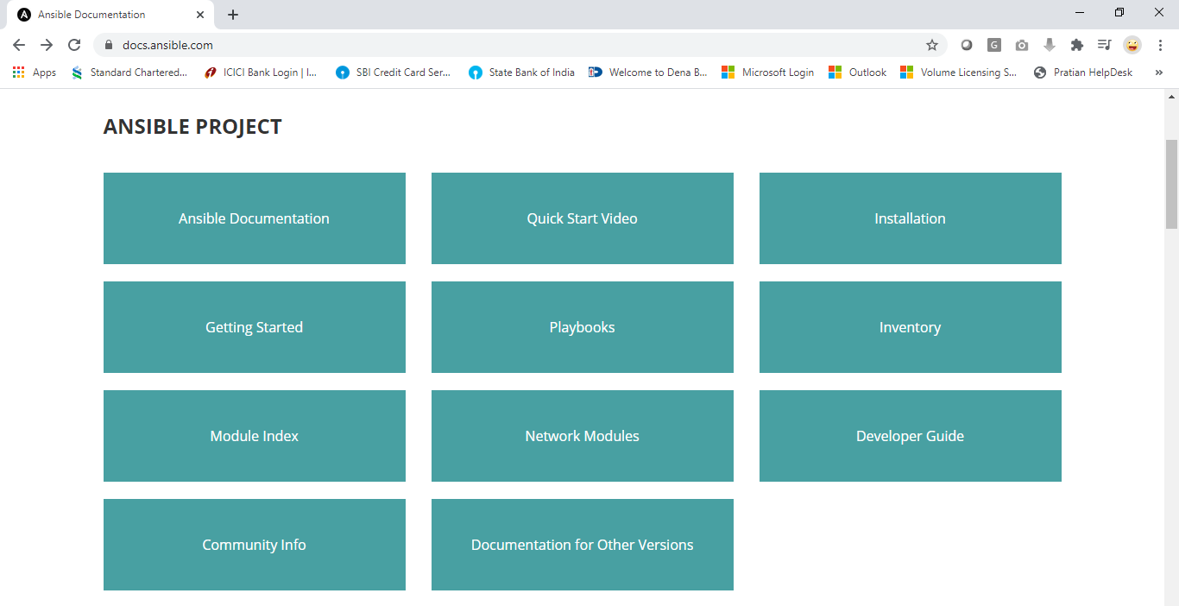
Ansible Documentation
The Ansible documentation pages are hosted at https://docs.ansible.com/
It’s very comprehensive and contains all information required to get started with Ansible.
There are hundreds of examples of playbooks in these pages.
Notes:
We will be referring to these while setting up installing Ansible.
That's a quick introduction to what Ansible is.
Why you might want to consider it and what it can do.

Slide 13
Thank You

